Slide 1
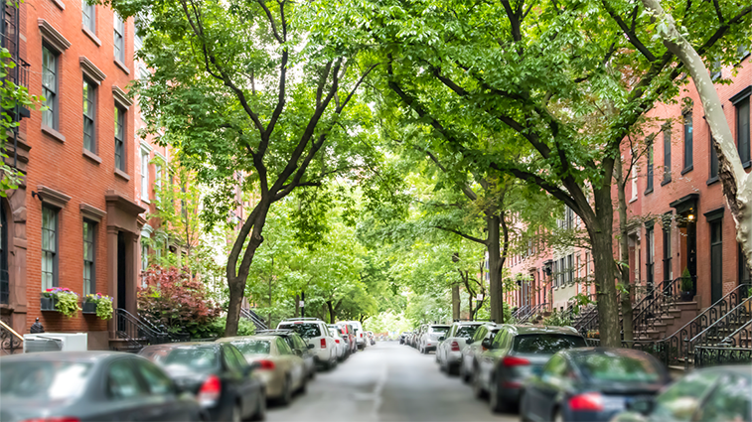
Re-foresting NYC
Reid Majka
Flatiron School Fall 2023

Slide 2
Introduction & Objective
Urban tree coverage is crucial to the success of urban environments¹
$60.1M in health impact reduction in NYC²
Stormwater mitigation
Urban heat effect
Increase property values
Community integration
Using data from NYC Opendata, create a machine-learning model to predict whether a tree is in need of care and/or replacement
Provide NYC Parks department with an optimized model to prioritize trees needing care, minimizing resources to fix and increase the canopy across the city
Notes:
https://www.nature.org/content/dam/tnc/nature/en/documents/Public_Health_Benefits_Urban_Trees_FINAL.pdf
2 - Nowak, D.J., et al., Modeled PM 2.5 removal by trees in 10 U.S. cities and associated health effects. Environmental Pollution, 2013. 178: p. 395-402.

Slide 3
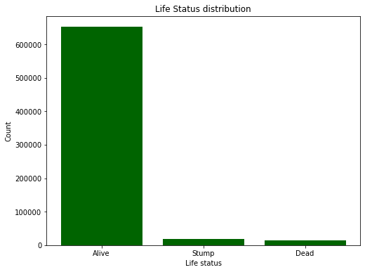
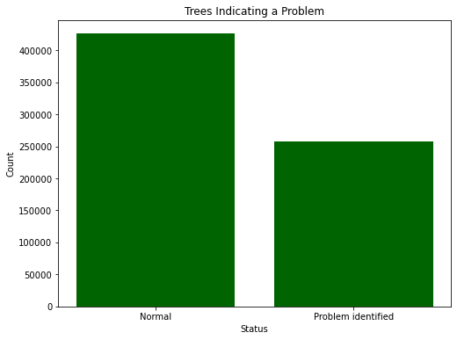
Data Background
Majority of trees are alive – this is good!
May cause some issues when creating a prediction model – to be discussed
More % of all trees have “Problems” that could lead to future decay/death
Dataset range of health: No Problems, Problems (with a wide range of values, assuming all “problems” carry equal importance)
Determine trees with problems as a first-response to care

Slide 4
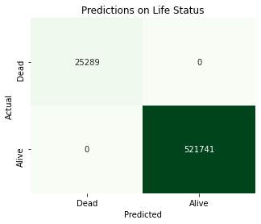
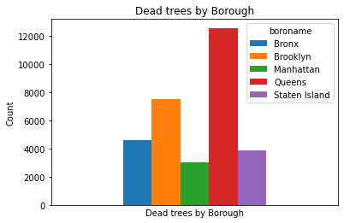
Predicting if a Tree is Dead / Stump in plot
Dataset binary classification: Alive or Dead/Stump
Predictions on Life status resulted in 100% Accuracy
Dataset not diverse enough to use this target variable

Slide 5
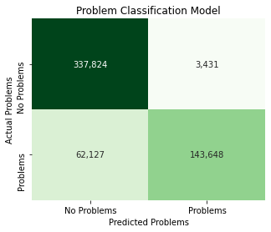
Predicting Problems – Baseline model
Factors included:
Community support (community board, steward(s), assessor)
Tree details (species, guards, trunk diameter, alive/dead status)
Geography (block location, district, borough, geo-coordinates)
Predictions on Problems resulted in 98% precision, 88% Accuracy, and 70% recall
Aiming for higher recall, to minimize chance a tree with problems is classified as “normal”

Slide 6
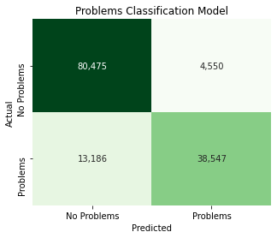
Optimized Logistic Regression Model
Predictions on Problems resulted in 90% precision, 87% Accuracy, and 75% recall
Fine-tuned model includes:
Increased iterations
Threshold of 35%
Lower regularization strength
Critical factors: guards, root system, steward availability
Decision tree modeling was assessed in process, and deemed unfit for success
Balancing data set did not result in improvements

Slide 7
Conclusion and next steps
Predictions on Life status (Alive vs. dead/stump) is too accurate based off data – prioritize re-planting at these sites with dead trees (or stumps)
Predictions on Health status vary – the model is good at predicting if the tree is alive, but more information is needed to predict if it is in sub-optimal health
Most importantly: just go outside and check! Call 311 if you see a tree in need.
Next Steps:
Partner with parks department to revisit trees in suboptimal health, and gather better data parameters in order to better tune the mode
Gather incremental data to increase performance:
Zoning district, air quality, demographics of surrounding population

Slide 8
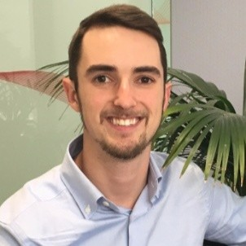

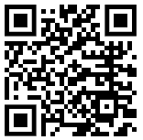

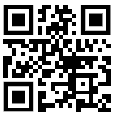

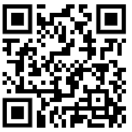
Questions

